Slide 1
Project Title: Restaurant POS Application
team members
Team memmers:Miho Akasaka, Azam Shirani Bidabadi
Fall 2017

Slide 2
Restaurant POS Application
Servers: order management and table management. They are able to send an order to kitchen quickly .For payment, they can split checks.
Managers : Manage employee information and see daily sales report.
Kitchen, receive order from servers

Slide 3
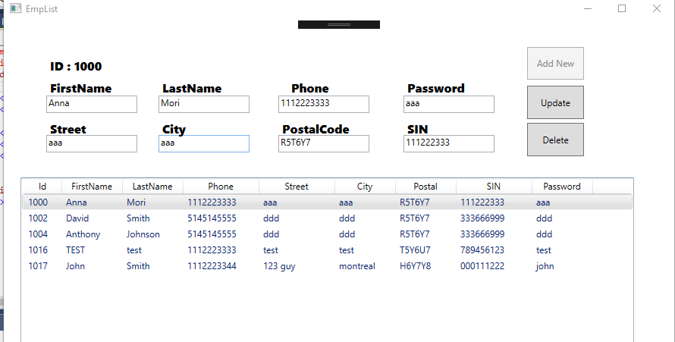
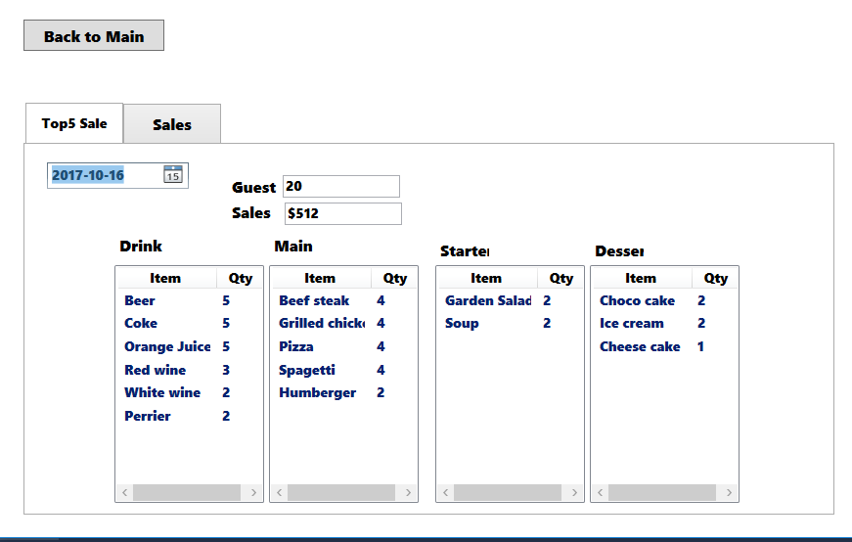
Manager: Employee management Sales Report

Slide 4
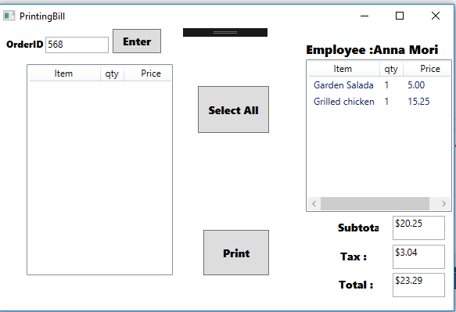
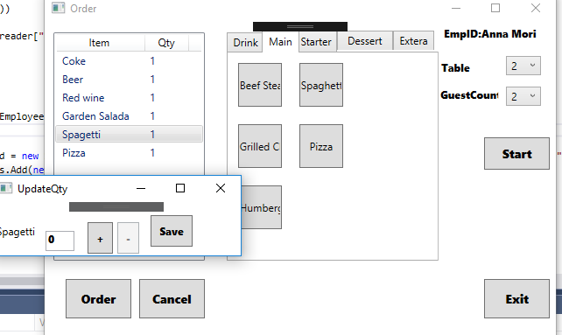
Waiter Order management, Bill print Chef Receive an order
overview

Slide 5
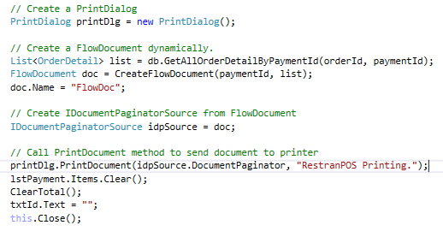
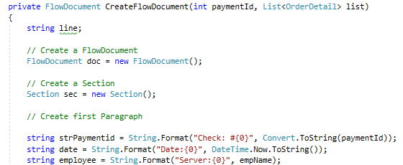
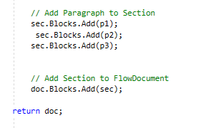
Printing
Printing

Slide 7
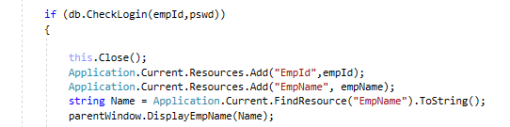
Global variable
Application.Current.Resourse

Slide 8
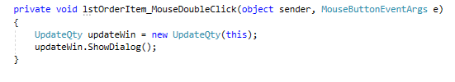
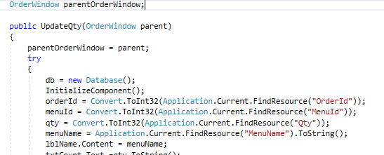
Refresh parent window

Slide 9
Futures task
Clock Time for Employee
Table Management
Add seat number in Order(so we can split bill by seatnumber)

Slide 10

Thanks

